Slide 1
Kristin.Gomez@APSVA.US
Abingdon Elementary Strings
Thomas Jefferson Middle School Orchestra

Slide 2
Welcome
Kristin.Gomez@APSVA.US
Abingdon Elementary Strings
Thomas Jefferson Middle School Orchestra

Slide 3
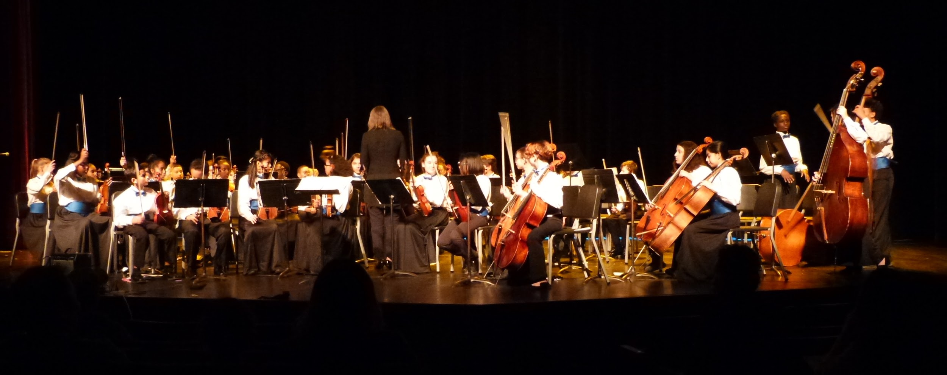
6th, 7th and 8th Grade
Orchestras.
Welcome to the award-winning Thomas Jefferson Middle School Orchestras.

Slide 4
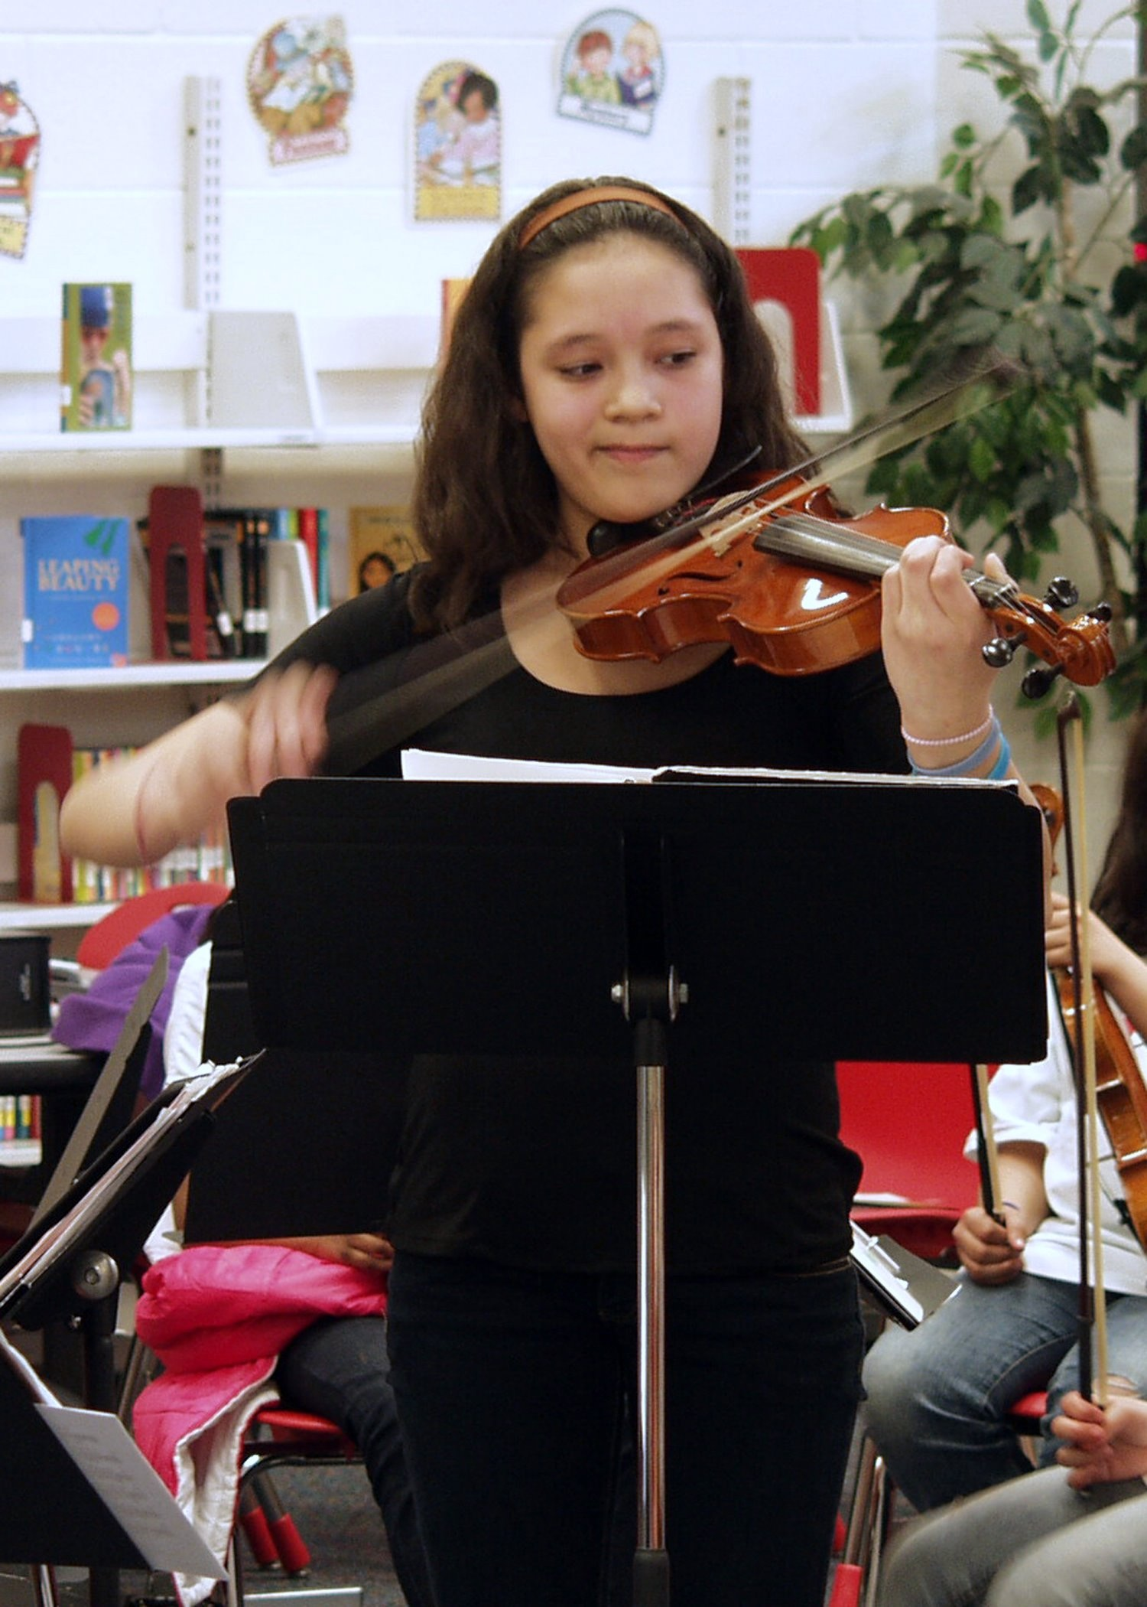
Program Goals
To develop lifelong learners.
To develop excellent musicians.
To provide an enriched artistic experience for our students.

Slide 5
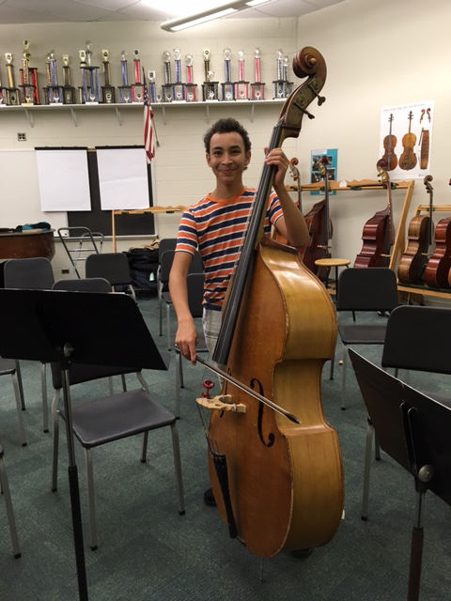
Program Goals
To develop how we play: technique.
To play a variety of repertoire from different time periods and genres.

Slide 6
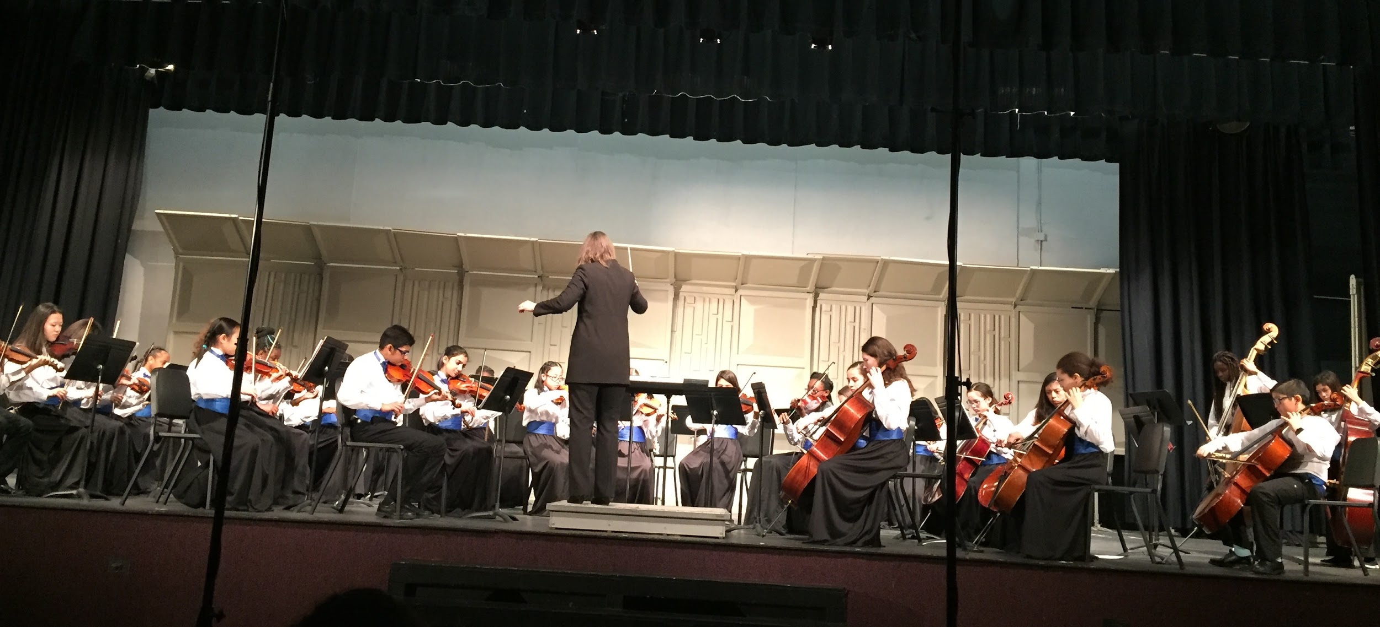
Program Goals
To follow to International Baccalaureate
units of learning.

Slide 7
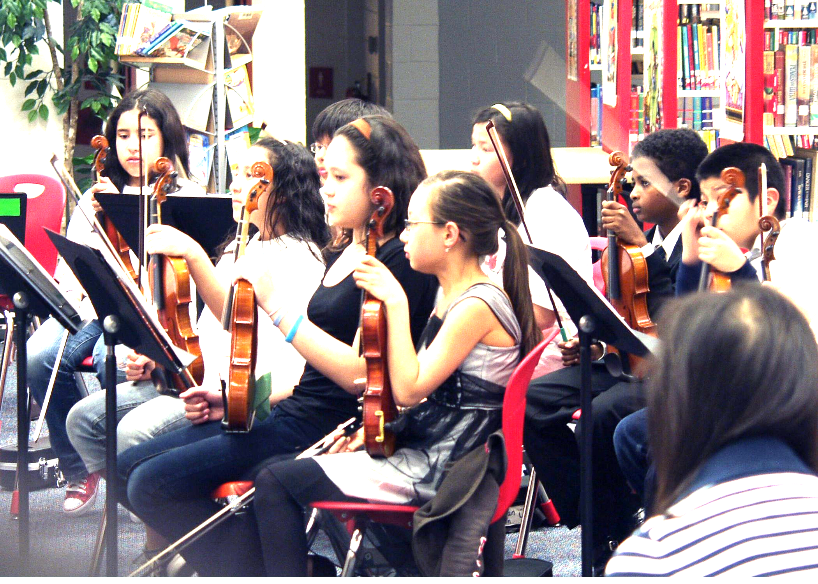
Rehearsals
Class is a rehearsal based upon the high standards of any professional orchestra.

Slide 8
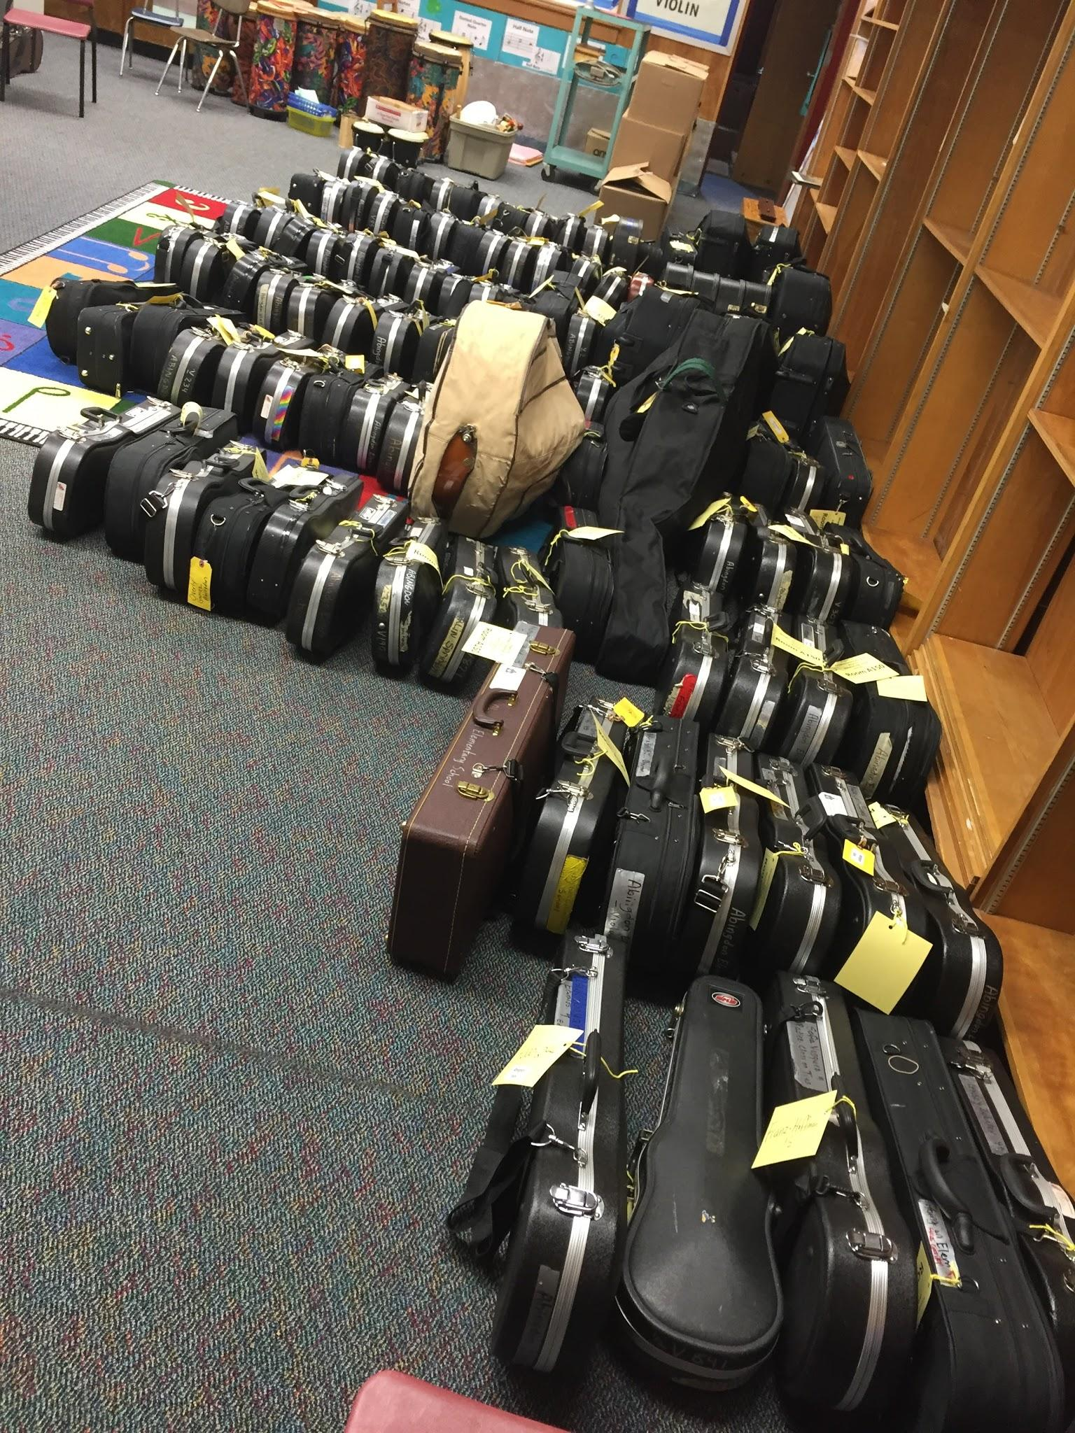
Instrument Rentals
Many instruments are available for rental. Please send in a rental form.
Forms are available on Canvas and on the class website.

Slide 9
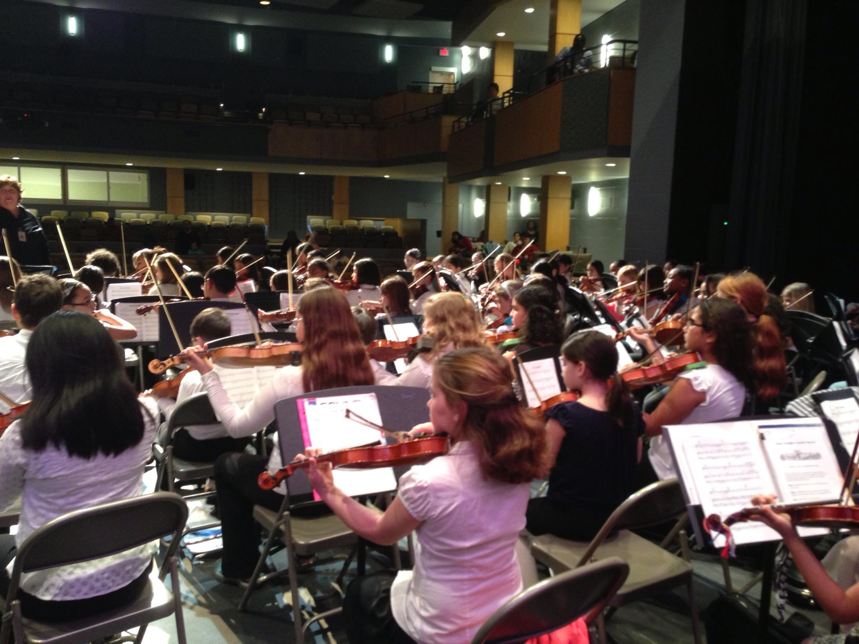
Concerts
We have at least two big concerts per year as well as a district assessment . We generally play a few recitals and farmers market concerts, also.

Slide 10
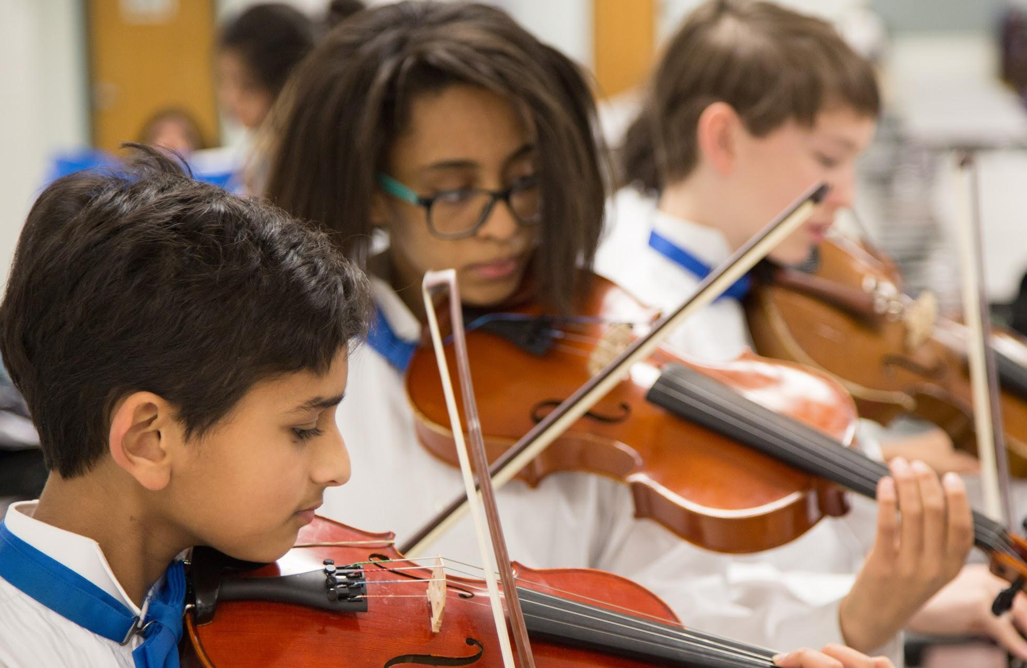
Class website and Canvas
Dates and information are both updated regularly on Canvas and on the class website.

Slide 11
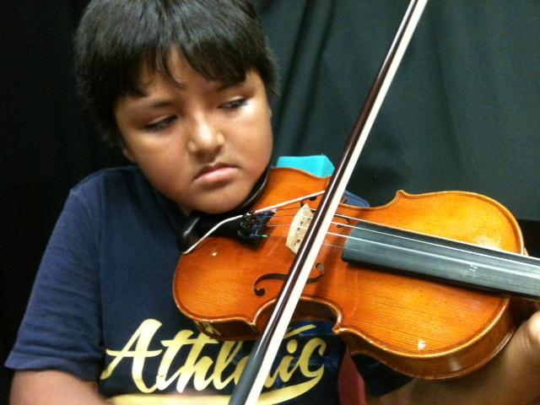
Home Practice
Students who
practice at home regularly are generally more successful in Orchestra.

Slide 12
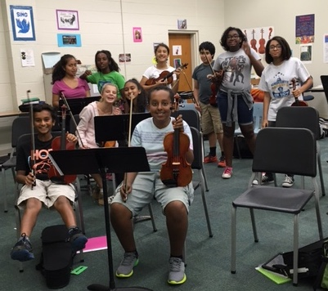
Fundraising
It is fun to participate in our fundraising activities such as car clean out days and yankee candle sales.

Slide 13
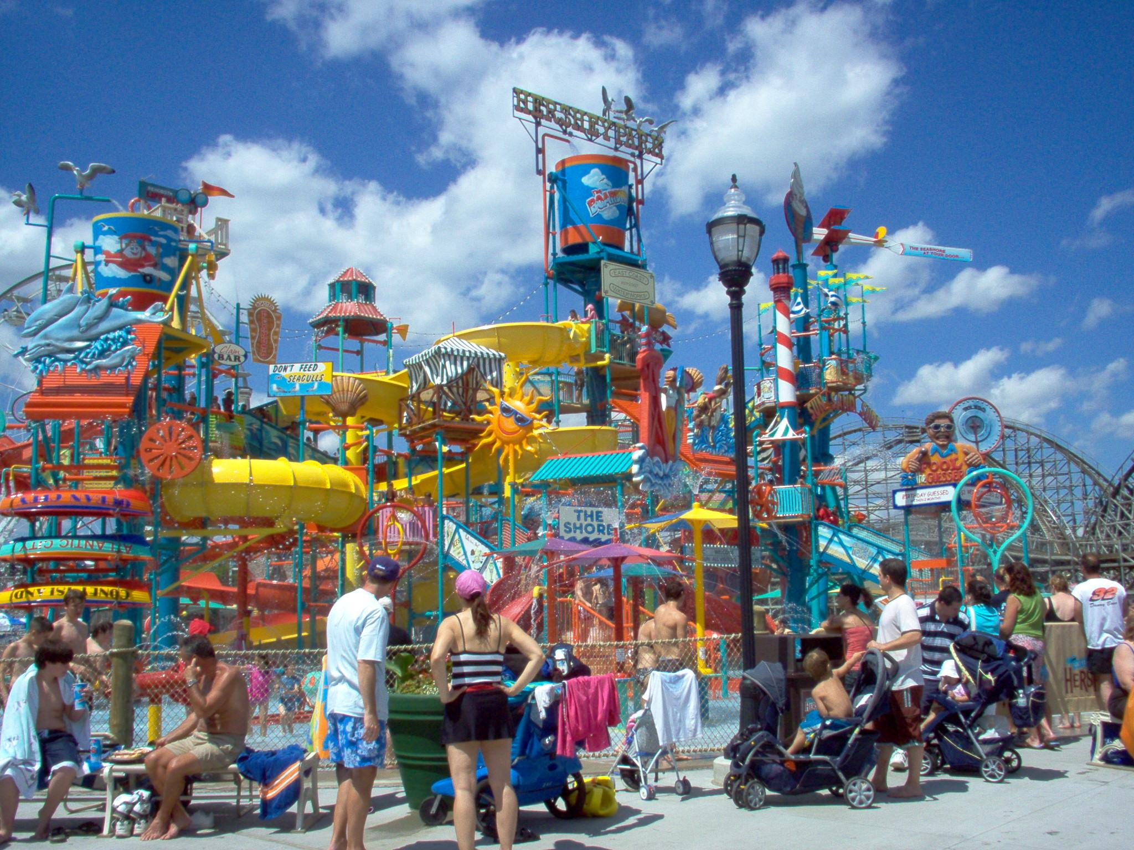
Hershey Park
In June, the orchestras will travel to Hershey Park, PA to play concerts and enjoy the park.

Slide 14
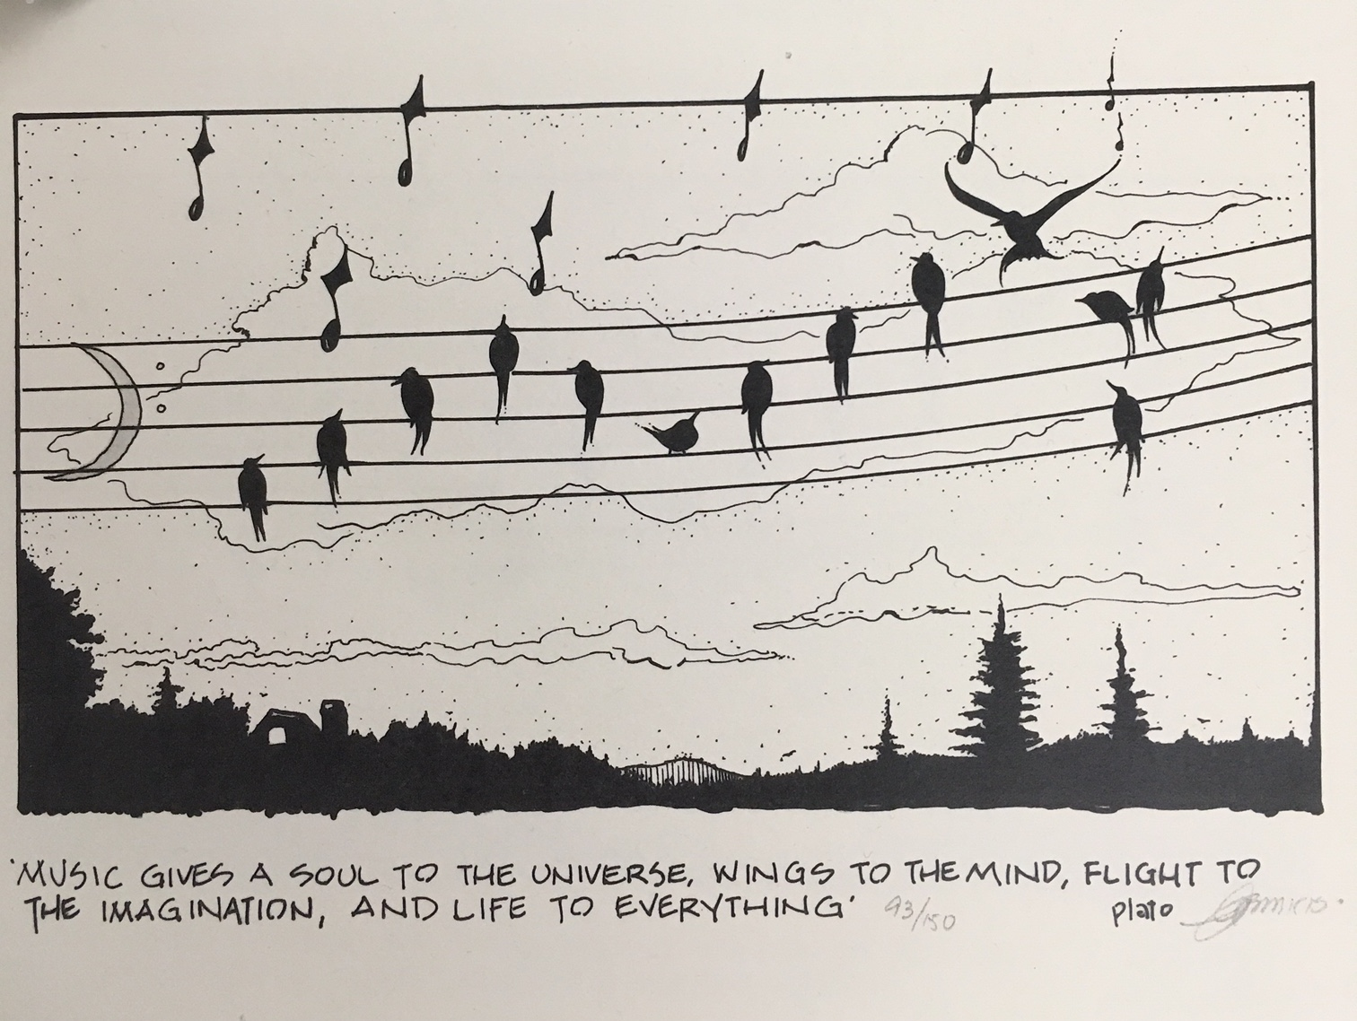

Slide 15
Thanks!
Welcome to the TJMS Orchestras!

